Slide 1
Resume Design
Resume “Gallery Walk”
Resume Design Workshop
Self Introductions (again, if time)
Jan 28, 2025
Engi 501
Dr. Mary Glavan

Slide 2
Resume “Gallery Walk”
Tape your resume to the wall
30 second “resume walk” rounds
What stands out as the most meaningful in the 30 seconds?
Notes:
Activity adapted from: https://slideplayer.com/slide/8104456/

Slide 3
Project 1 Instructions

Slide 4
Document Design
The process of choosing how to present all of the basic document elements so your document's message is clear and effective.
Document design is the “nuts and bolts” of technical and professional communication.
No matter how brilliant or important the content, if it is not formatted in a way that enhances usability, it will likely not receive the attention it deserves.
Notes:
From: https://pressbooks.bccampus.ca/technicalwriting/part/documentdesign/
From: https://edis.ifas.ufl.edu/publication/WC127

Slide 5
Queuing and Filtering

Slide 6
Queuing is the visual distinction we make to indicate levels of importance in a document
Larger more emphatic elements are more important (size, weight, color)
Left aligned text is more important than indented text
Filtering refers to visual patterns that distinguish different types of information.
We create patterns using differences in color, size, fonts, icons, and page layout
Repetition is crucial
Notes:
Pull quote example from: https://horserookie.com/how-to-ride-a-horse-for-beginners/

Slide 7
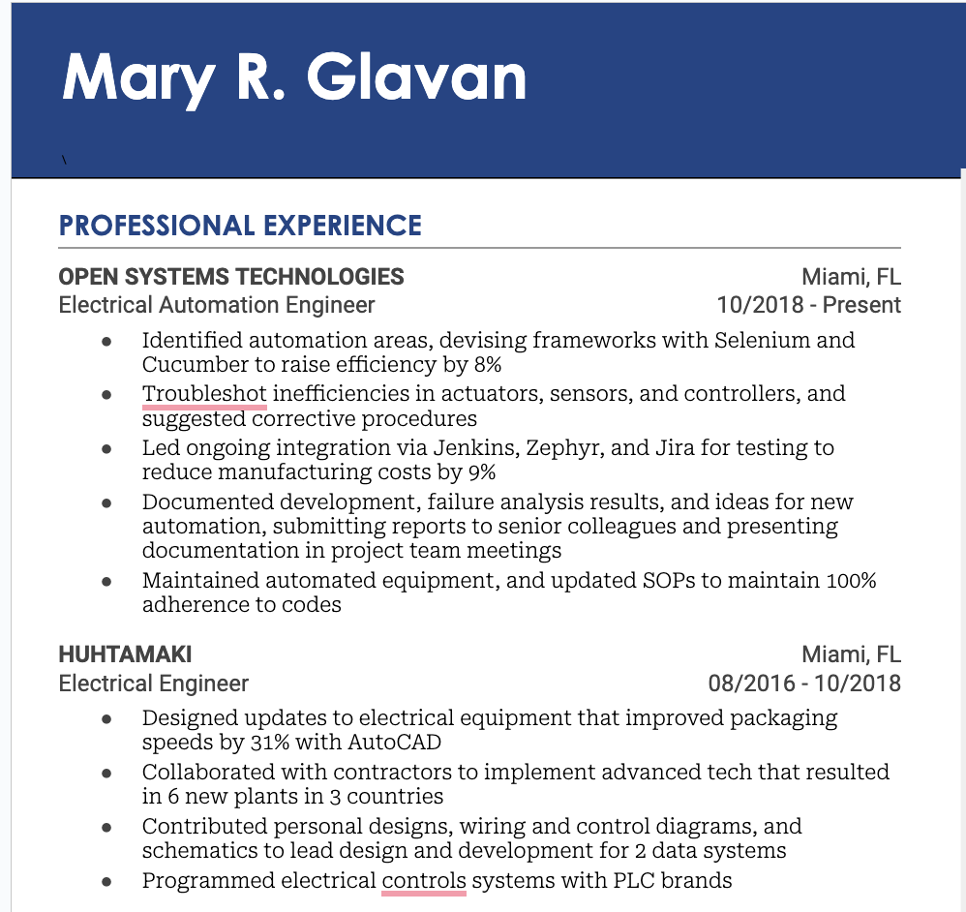
Example Queuing: How does the design show the levels of importance of the information?
Heading is “queued” as most important:
Size (27) and weight (bold) font (century gothic)
Strong color contrast
Location: top/left corner
Professional experience is “2nd” level of important
All caps
12 pt font
Bold
Color (blue)
Above a “rule”
Near the top, left aligned
Company name is queued as 3rd level of importance
All caps
Bold, black font
Roboto typeface
10 pt font
Top of this section
Left aligned
Position title is 4th level
Title case
10 pt, “regular” weight
Color (Dark gray)
Near the top, left aligned

Slide 8
Example Filtering: How do repeated visual patterns distinguish types of information
Design “filters” heading:
Only instance of this design on the resume.
It’s position at the top tell us it’s a title, as does its other design features.
This is a section heading; the design is repeated throughout the resume
All caps
12 pt, century gothic
Bold, Color (blue)
Above a “rule”
Near the top, left aligned
These are titles within the section; the design is repeated through the resume
All caps
Bold, color (dark gray)
Roboto, 10 pt font
Top of this section
Left aligned
This is a sub-title within the section; the design is repeated
Title case
10 pt, “regular” weight, Roboto
Color (Dark gray)
Near the top, left aligned

Slide 9
4 basic design principles to improve
the document design of your resume.

Slide 10
C.
Avoid elements on the page the are merely similar. If the elements (typeface, color, size, line thickness, shape, space, etc.) are not the same, then make them different. Contrast is what makes a reader look at the page in the first place. And it clarifies what’s most important.
Contrast
R.
Repeat elements throughout the page. These include shapes, fonts, sizes, colors, spacial relationships, and line thickness, as well as layout patterns. Repetition develops the organization and strengthens the unity of the document
Repetition
A.
Nothing should be placed on the page arbitrarily; everything should be a deliberate choice. All the elements should visually connect with other elements, and facilitate easy comprehension and readability. Think especially about vertical gridlines!
Alignment
P.
Place similar design elements close together. When items are positioned relatively close to each other, they are perceived as one visual unit rather than several separate units. This helps organize information, reduce clutter, and provides the reader with a clear structure.
Proximity
Adapted from Robin Williams’ The Non-designer Design Book

Slide 11
C.
R.
A.
P.
Avoid elements on the page the are merely similar. If the elements (typeface, color, size, line thickness, shape, space, etc.) are not the same, then make them different. Contrast is what makes a reader look at the page in the first place. And it clarifies what’s most important.
Contrast
One of the best ways to show contrast in a resume is through typography
Notes:
Image from: https://saylordotorg.github.io/text_business-information-systems-design-an-app-for-that/s07-01-c-r-a-p-principles-of-graphic-.html

Slide 12
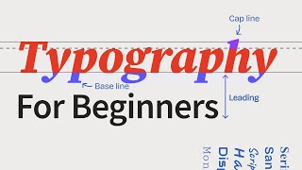

Slide 13
San-Serif, Serif, Script, Decorative/Display, and Monospaced
Debugging is like being the detective in a crime movie where you’re also the murderer.
San-Serif
Raleway, Normal, 12 pt
Debugging is like being the detective in a crime movie where you’re also the murderer.
Serif
Times New Roman
18 pt
Script
Pacifico, 14 pt
Debugging is like being the detective in a crime movie where you’re also the murderer.
Decorative/
Display
Syncopate 12 pt
Debugging is like being the detective in a crime movie where you’re also the murderer.
Debugging is like being the detective in a crime movie where you’re also the murderer.
Monospaced
Courier New, 18 pt
Notes:
Definition of typography from Markel and Selber p. 162; wardrobe metaphor from: OpenAI. (2023). ChatGPT (September 25 Version) [Large language model]. https://chat.openai.com/share/4e8e4b45-ddd7-4c38-9e75-857430f57ea1

Slide 14
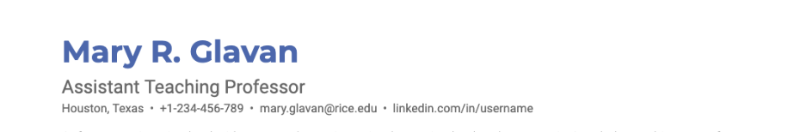
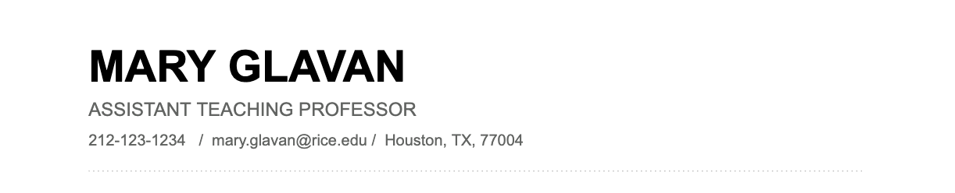
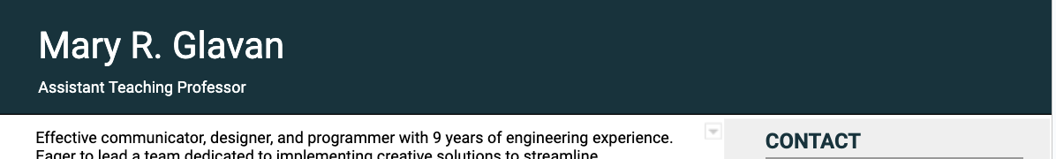
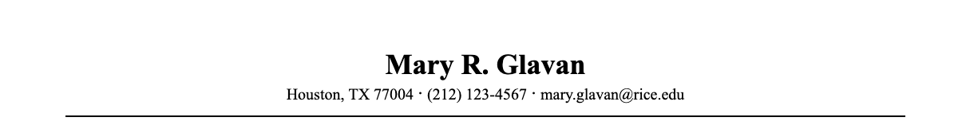
Resume Headings
Contrast

Slide 15
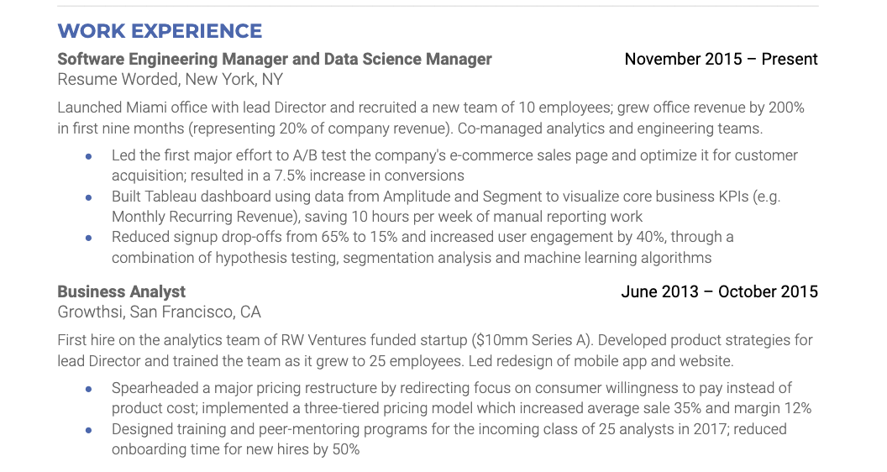
How many different contrast techniques do we see here?
Font (Montserrat) Color (blue) + weight (bold) + form (all caps) + size (13 pt)
Font (Roboto) Weight (Bold) + Color (dark gray) + Size (11pt)
Font weight (Roboto, normal) + color (black) + size (11pt)
Weight (light) + color (dark gray) + size (10pt)
How many contrast techniques are you using in your own resume? Where are they?
Contrast

Slide 16
Resume Header | What should the section include? | What should the section look like?
 | Name (include your surname) Phone number Location (not actual address; can indicate willingness to relocate if not local) Email (without http://) LinkedIn and/or personal website Optional: github, links to other impressive sites (i.e., portfolio) | Position at the top Use larger font for name (at least 16 pt.) and other design features that create contrast: bold, capitalization, small caps, font variant, color?!? Pay attention to alignment and other design elements to focus user’s eye
Design Challenge | Consider designing a heading that you can also use for your cover letter.
Notes:
https://zety.com/blog/education-on-resume#:~:text=Where%20Should%20Education%20Go%20on,most%20recent%20degree%20goes%20first.
chrome-extension://efaidnbmnnnibpcajpcglclefindmkaj/https://ccd.rice.edu/sites/g/files/bxs3401/files/inline-files/resumewriting.pdf

Slide 17
R.
Repeat elements throughout the page. These include shapes, fonts, sizes, colors, spacial relationships, and line thickness, as well as layout patterns. Repetition develops the organization and strengthens the unity of the document.
Repetition
Repetition is the primary way that we filter information
Notes:
Adapted from Robin Williams’ The Non-designer Design Book

Slide 18
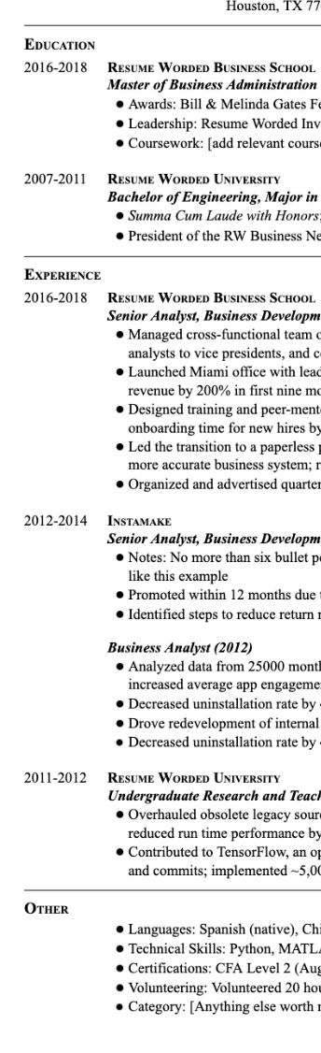
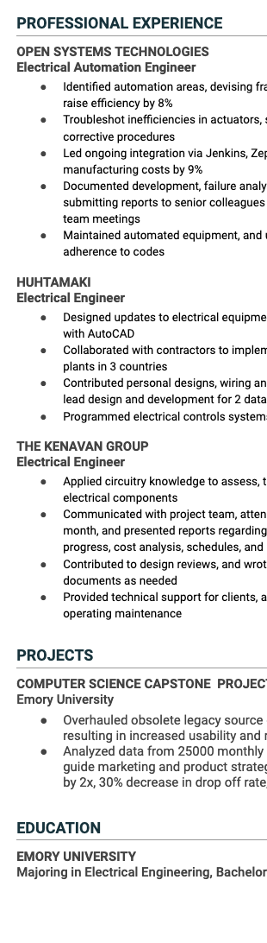
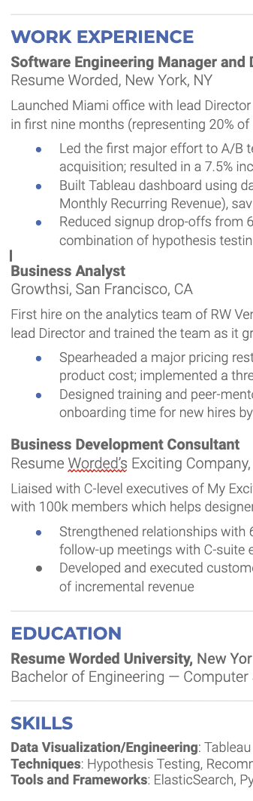
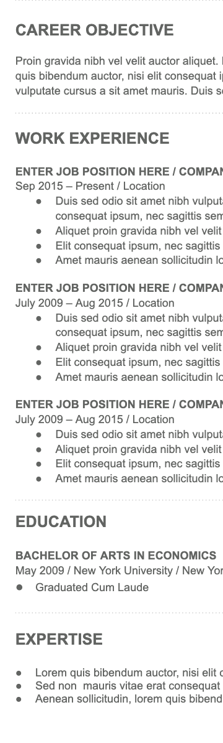
What design features are repeated on each example?
Across the examples?
Repetition
Notes:
Adapted from Robin Williams’ The Non-designer Design Book

Slide 19
What features are repeated in this work experience section?
Titles of position repeat same font, size, weight, color and alignment
Company names and locations repeat the same font, size, weight, and color
Dates are repeat same font, size, color, weight, and right alignment. They are all on the same horizontal line as the position. Dates use the same formatting
Position summaries repeat same font, size, weight, and color and have full left alignment
Bullets points repeat font, size, weight, and color. Share same indentation. All start with a past-tense verb
What features are clearly repeated throughout your resume?
Repetition

Slide 20
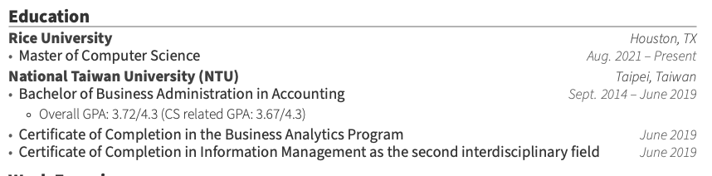
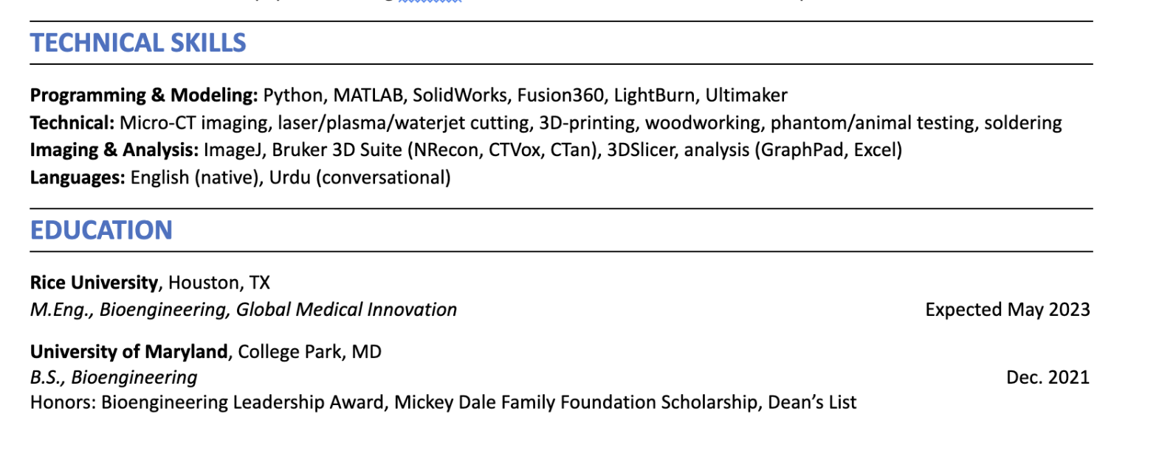
Note how the repeated use of contrast (in text size, bolding, and weight) makes this education section easier to skim
This education section is at the end of the resume

Slide 21
Education Section | What should the section include? | What should the section look like?
 | Name and location (city, state) of school attended Degree: check job ad for to see how degree is formatted, i.e., Bachelor of Arts, or B.A. or BA) Year of degree completion or expected month and year of graduation Major(s) and Minor(s) GPA: if above a 3.0; GPA in your major if above 3.0 but your cumulative is not Optional if relevant: class standing, elective concentrations, coursework, thesis and/or dissertation topics | Use reverse chronological order Use design features that highlight the most important aspects of your education. Pay particular attention to alignment, contrast, and repetition across each degree/accomplishment
Design Challenge | Is your work experience more impressive than you education? If so, consider putting your education at the bottom rather than the top.

Slide 22
A.
Nothing should be placed on the page arbitrarily. Everything should be a deliberate choice. All elements should show visual interconnection with other like element. Think especially about vertical gridlines!
Alignment
Alignment is another way to effectively queue information
Adapted from Robin Williams’ The Non-designer Design Book
Notes:
Example from:https://slideplayer.com/slide/8104456/

Slide 23
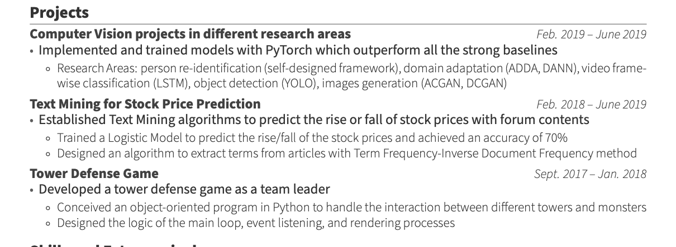
Right alignment is useful for skimming for dates
Full left alignment is most important
Indentation shows decreasing levels of importance
How much more skimmable would the dates be if the text wrapped at the 2nd line rather than the 3rd?
Alignment
Adapted from Robin Williams’ The Non-designer Design Book
Notes:
Example from:https://slideplayer.com/slide/8104456/

Slide 24
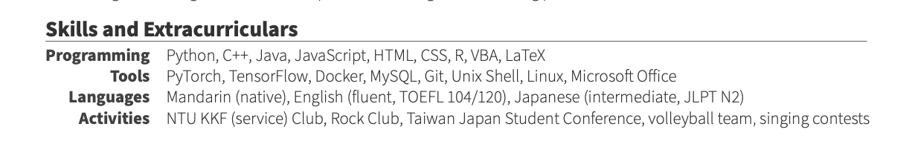
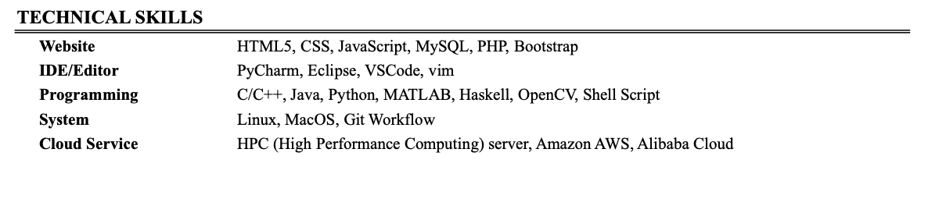
P.
Place similar design elements close together. When items are positioned relatively close to each other, they are perceived as one visual unit rather than several separate units. This helps organize information, reduce clutter, and provides the reader with a clear structure.
Proximity
Effective use of proximity
Less effective use of proximity
Adapted from Robin Williams’ The Non-designer Design Book
Notes:
Example from:https://slideplayer.com/slide/8104456/

Slide 25
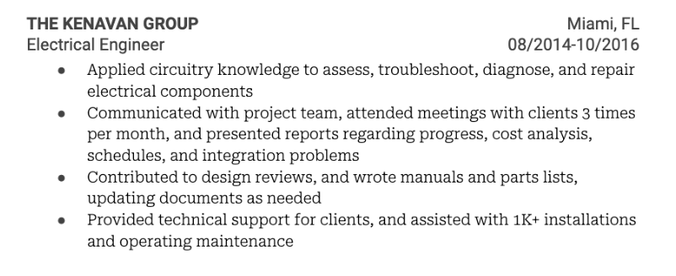
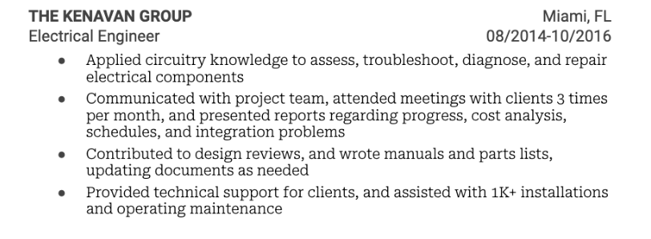
Can you spot the difference between these two?

Slide 26
Line spacing is a subtle way to we use the proximity

Slide 27
C.
Avoid elements on the page the are merely similar. If the elements (typeface, color, size, line thickness, shape, space, etc.) are not the same, then make them different. Contrast is what makes a reader look at the page in the first place. And it clarifies what’s most important.
Contrast
R.
Repeat elements throughout the page. These include shapes, fonts, sizes, colors, spacial relationships, and line thickness, as well as layout patterns. Repetition develops the organization and strengthens the unity of the document
Repetition
A.
Nothing should be placed on the page arbitrarily; everything should be a deliberate choice. All the elements should visually connect with other elements, and facilitate easy comprehension and readability. Think especially about vertical gridlines!
Alignment
P.
Place similar design elements close together. When items are positioned relatively close to each other, they are perceived as one visual unit rather than several separate units. This helps organize information, reduce clutter, and provides the reader with a clear structure.
Proximity
Adapted from Robin Williams’ The Non-designer Design Book

Slide 28
3 RESUMES
What is visually memorable?
What do you like? What do you dislike?
Use the visual design principles to explain your choices
Contrast
Repetition
Alignment
Proximity

Slide 29
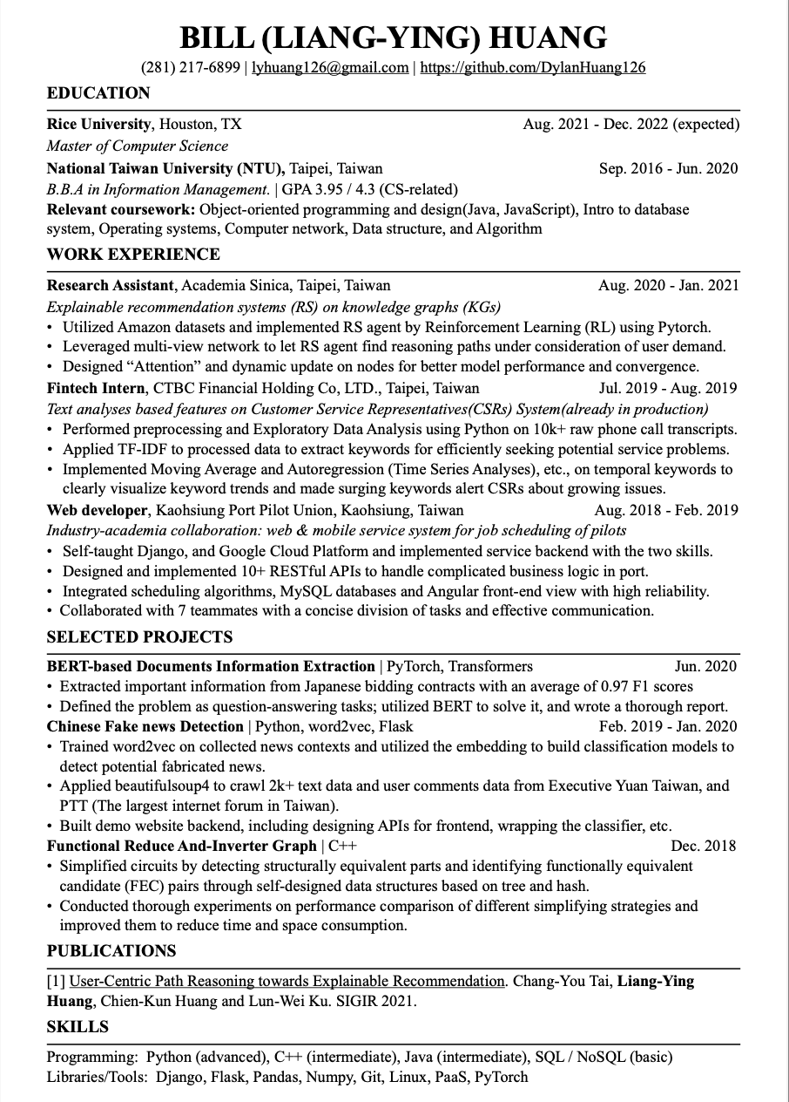
Résumé A

Slide 30
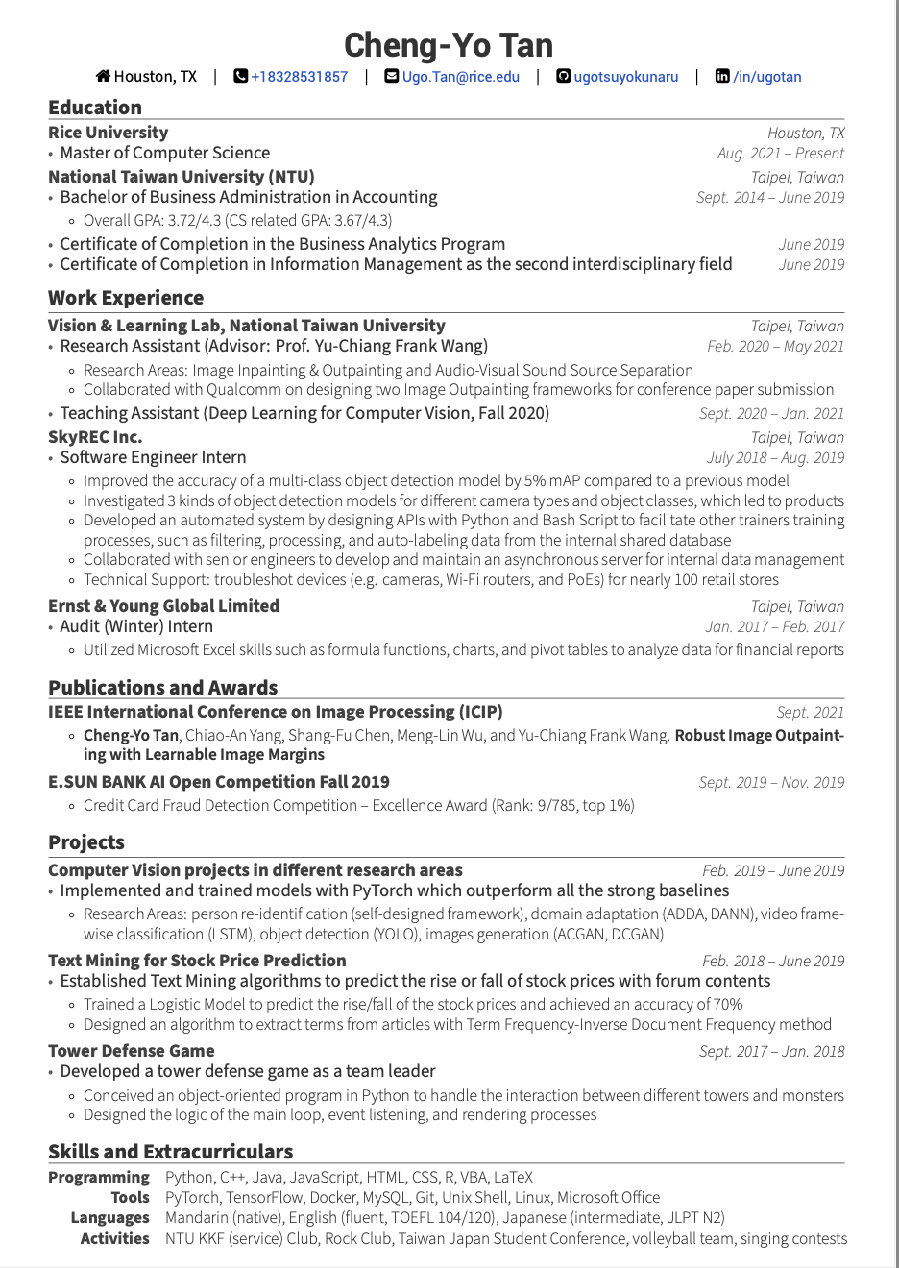
Résumé B

Slide 31
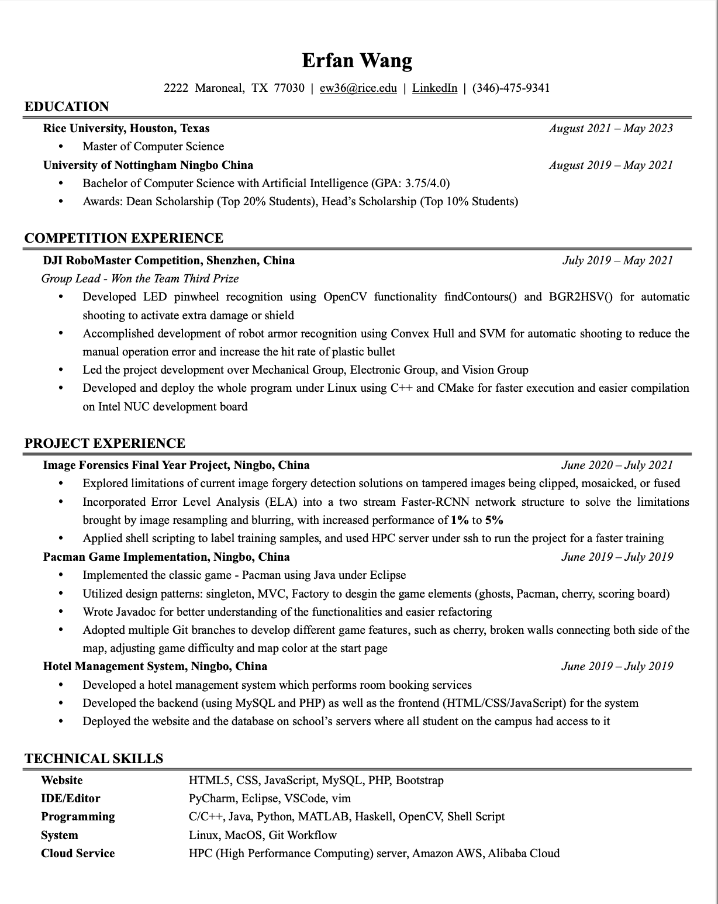
Résumé C

Slide 32
What stood out? What was memorable? What did you like? What did you dislike?
Résumé A
Use the visual design principles to explain your choices
Résumé B
Résumé C
Note: if you’re accessing these slides outside of class, be sure to view them in present mode view animations

Slide 33
Résumé A

Slide 34
Résumé B

Slide 35
Résumé C

Slide 36
Typography Activity
Google Doc for In-Class Activity
Instructions
Copy and paste the Work Experience text below into a new word processing document: Gdoc, word doc, or pages.
Using the typography principles we learned in the video, redesign the work experience section so that it is visually appealing and easier to read.
Create as much contrast and information hierarchy as possible. Creativity is most important!
Copy and paste your redesigned Work Experience into the document below.
Review and decide which redesign you like best!

Slide 37
Introductions (again)

Slide 38

Imagine you’re at the spring career expo. You’ve been waiting in line for an hour to speak with the recruiter from your DREAM company. It’s near the end of the event. You finally you get your turn to speak to the recruiter, but you notice that they look very tired when they say hello. How will you make the best impression when you introduce yourself to the recruiter?

Slide 39
Beginning
What to do?
Smile
Make eye contact
Shake hands
Hand them your resume right away
Be organized with your stuff
What to say?
Greeting
Name
(Pleasantry)
Background (very brief)
Purpose/Question
Middle: Wait for them to ask more about you before you dive into more information about yourself
End: Ask a good question
Notes:
Image: https://ageofthrivability.com/files/2019/01/1yzgJ-66YvsokIvqw93jiJQ.png

Slide 40
How to End Your Introduction
I noticed the job description for [open role] listed [some vague item] in the responsibilities—what do you mean by that?
In a typical day, what does [open role] do?
What’s the biggest challenge the new [open role] can help solve?
What does the hiring process for [open role] look like?
Can you tell me a little bit about the different stages in the hiring process for [open role]?
What kind of person is most successful at [Company]?
Diversity is really important to me. How do you support different identities?
What are the professional growth or development opportunities? Does the company support ongoing education and learning?
What two or three qualities define a top performer at your company?
======
What’s the best way to stay in touch with you?
What would be a great next step to take after meeting you here?
Who can I follow up with about [open role]?
DON’T ASK:
“Do you have any open positions”
“Can you tell me about the open positions at your company?”
“Do you sponsor international students?”
“What are the main responsibilities of [the position]?”
DO:
Research open roles at the company and showcase your knowledge by asking good questions that are EASY to answer.
Notes:
https://www.themuse.com/advice/questions-to-ask-at-career-fairs

Slide 41
Let’s Practice
Find a partner: one person is the student; the other is the recruiter
Stand up
Grab your stuff
Introduce yourself
Give your resume
End the interaction
Switch and repeat
Discuss (first with partner, then with the class)

Slide 42
ATS Optimization Strategies for your resume
Avoid complex formatting: headers, footers, tables, templates, borders, columns, and boxes.
Avoid complex tables: You should NEVER layout your entire resume or large sections of your resume using a complex table. But, it is ok to use very simple tables in an ATS-friendly resume. Using a simple table helps present part of the resume content in an attractive and easy-to-read way. See this article for advice on how to use tables.
Graphics and colors are fine, but may take up valuable space. The ATS will not likely read the words enclosed.
Write out months and years so it’s readable by ATS systems. Abbreviated months are fine (Jan., Feb.,)
An MS Word documents may be more compatible with an ATS
Use keywords and exact phrases from the job description throughout your resume and online application. Keywords are graded both by how often they appear and the extent to which they get used in context.
Tailor your resume for each position–use different keywords (which means analyzing all ads).
Use common names for your section headers (Education, Work Experience, Leadership, Skills).
Be careful with abbreviations. Only abbreviate terms (i.e. B.S. degree) if it is also abbreviated in a job description (ATS search filters might not be very intelligent)
Do not put distinctions (i.e. PhD or CPA) into your resume heading as ATS systems will pull that into your ﬁrst name/last name box
A professional summary statement utilizing keywords can be helpful, especially if you’re transitioning to a new career pathway. (We’ll work on these when we do LInkedIn stuff, but see the next slide for some examples.)

Slide 43
Typeface
A set of glyphs (letters, numbers, punctuation marks and symbols) all bearing a characteristic design.

Slide 44
Fonts are specific instances of a typeface, including size, weight, width, and slant
Debugging is like being the detective in a crime movie where you’re also the murderer.
When I wrote this code, only me and God knew how it works. Now only God knows…
Software undergoes beta testing shortly before it’s released. Beta is Latin for ‘still doesn’t work.’
Raleway, 13
- Normal
- Italics
- Black
Debugging is like being the detective in a crime movie where you’re also the murderer.
When I wrote this code, only me and God knew how it works. Now only God knows…
Software undergoes beta testing shortly before it’s released. Beta is Latin for ‘still doesn’t work.’
Times New Roman, 12 - Regular
- Italics
- Bold
Debugging is like being the detective in a crime movie where you’re also the murderer.
When I wrote this code, only me and God knew how it works. Now only God knows…
Software undergoes beta testing shortly before it’s released. Beta is Latin for ‘still doesn’t work.’
Pacifico, 12
- Regular
- Italics
- Bold
Notes:
Definition of typography from Markel and Selber p. 162; wardrobe metaphor from: OpenAI. (2023). ChatGPT (September 25 Version) [Large language model]. https://chat.openai.com/share/4e8e4b45-ddd7-4c38-9e75-857430f57ea1

Slide 45
Within a font-family, you can change the size, weight, case, and color to meet your design purposes
Debugging is like being the detective in a crime movie where you’re also the murderer.
WHEN I WROTE THIS CODE, ONLY ME AND GOD KNEW HOW IT WORKS. NOW ONLY GOD KNOWS…
Raleway, 16, thin, sentence case, Hex #000000
Raleway, 12, italics, upper case, Hex #307530
Debugging Is Like Being The Detective In A Crime Movie Where You’re Also The Murderer.
Software undergoes beta testing shortly before it’s released. Beta is Latin for ‘still doesn’t work.’
Times New Roman, 20, title case, Hex #00ffff
Times New Roman, 12, italics, sentence case, Hex #000000
When I wrote this code, only me and God knew how it works. Now only God knows…
SOFTWARE UNDERGOES BETA TESTING SHORTLY BEFORE IT’S RELEASED. BETA IS LATIN FOR ‘STILL DOESN’T WORK.’
Oswald, 20, light, sentence case, Hex #741b47
Oswald, 12, normal, uppercase, hex #000000
Notes:
Definition of typography from Markel and Selber p. 162; wardrobe metaphor from: OpenAI. (2023). ChatGPT (September 25 Version) [Large language model]. https://chat.openai.com/share/4e8e4b45-ddd7-4c38-9e75-857430f57ea1

Slide 46
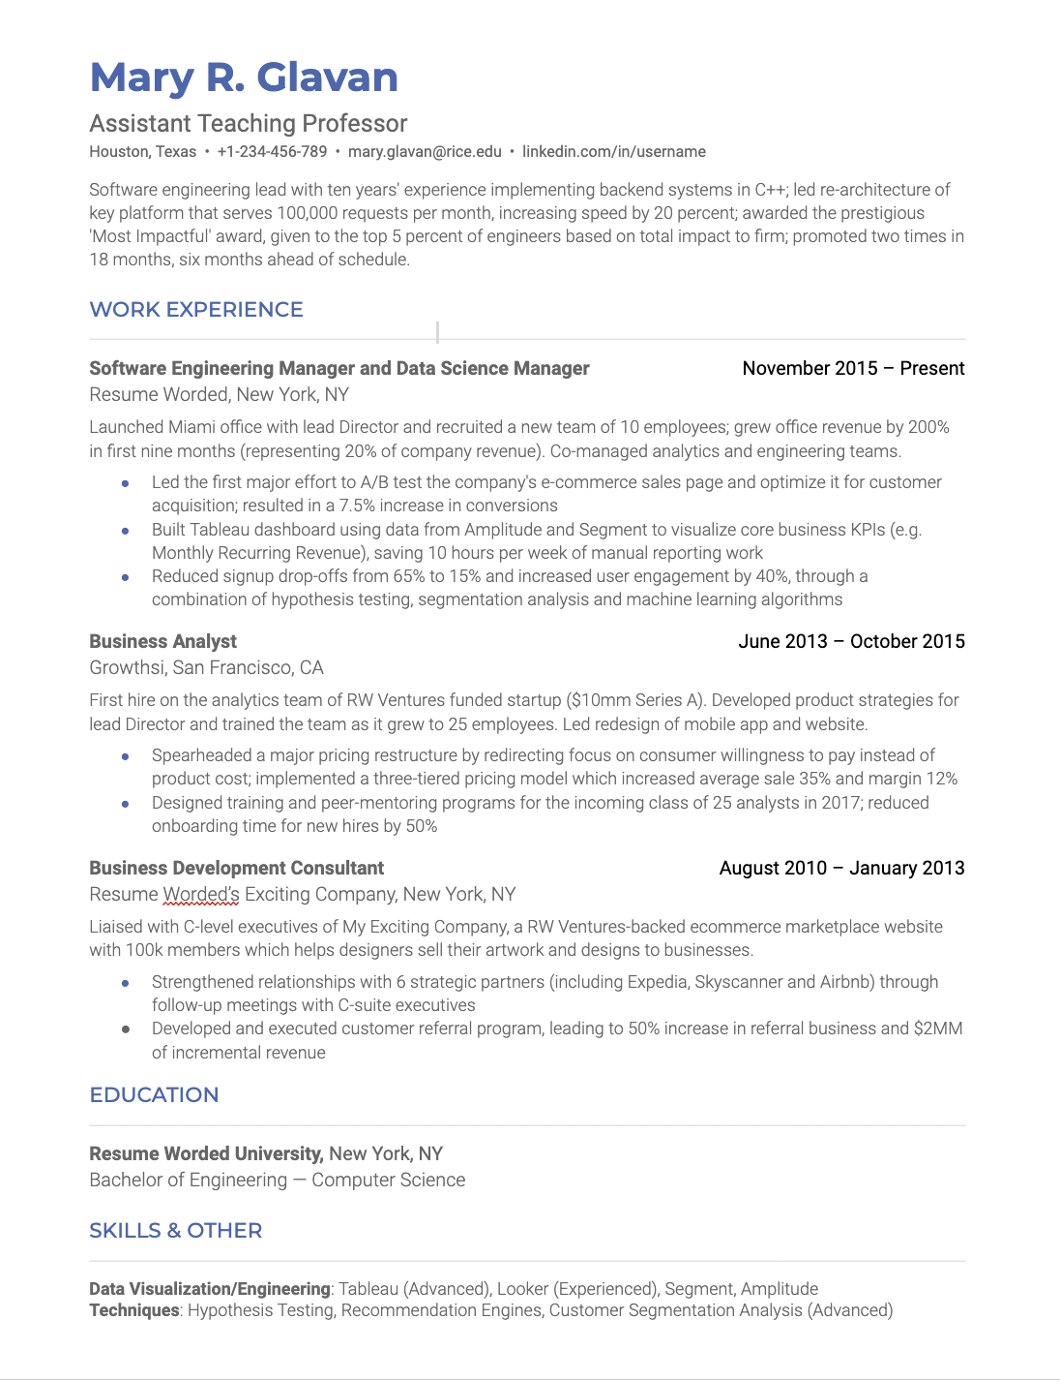
A

Slide 47
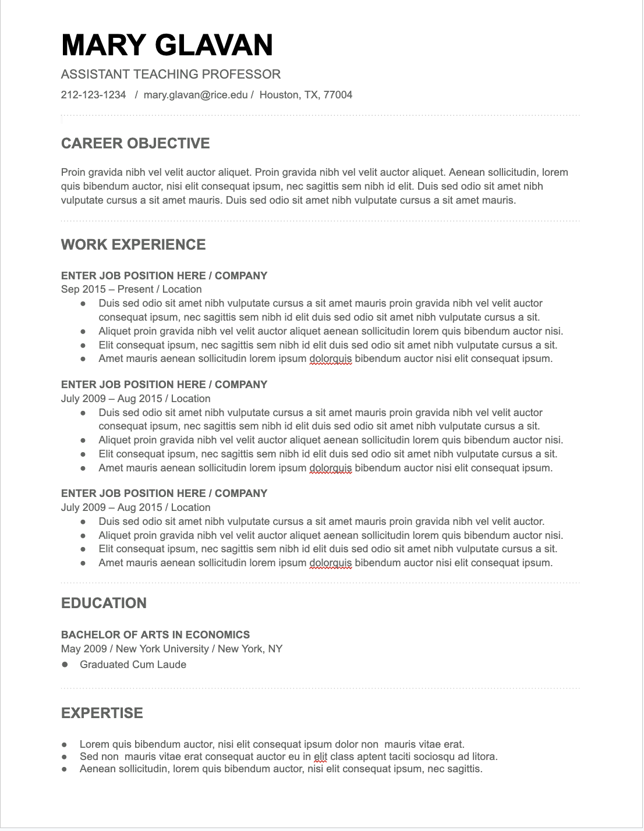
B

Slide 48
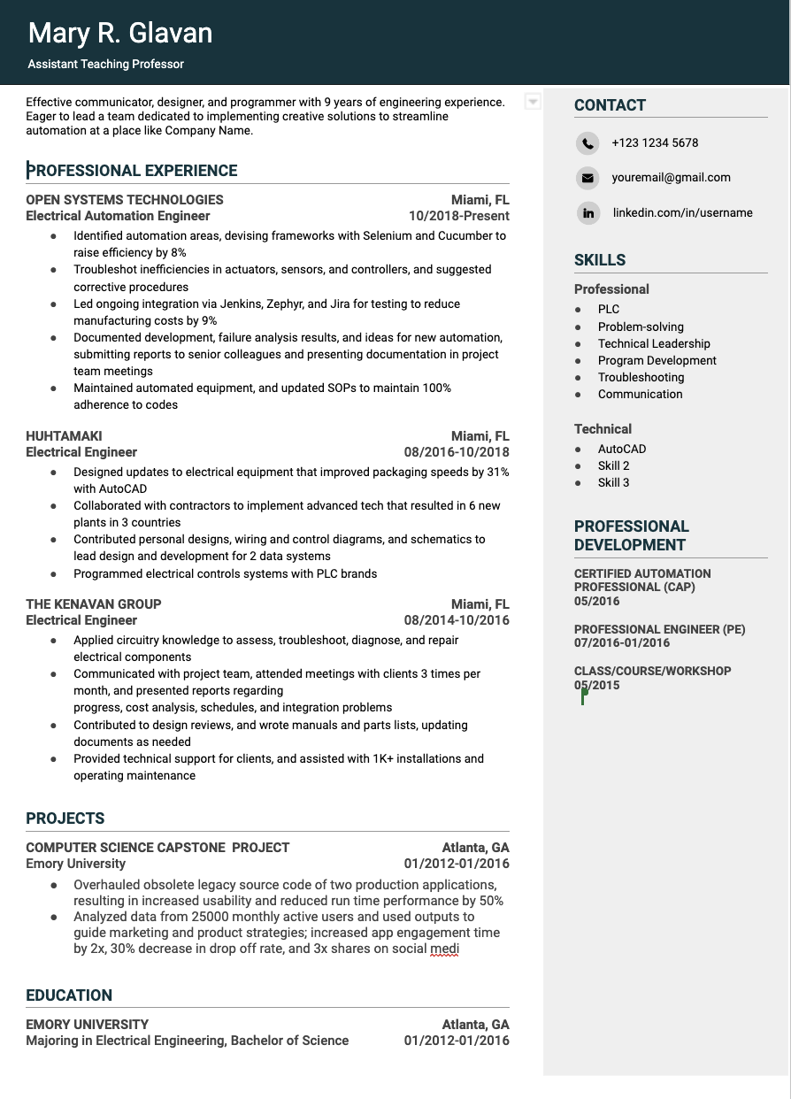
C

Slide 49
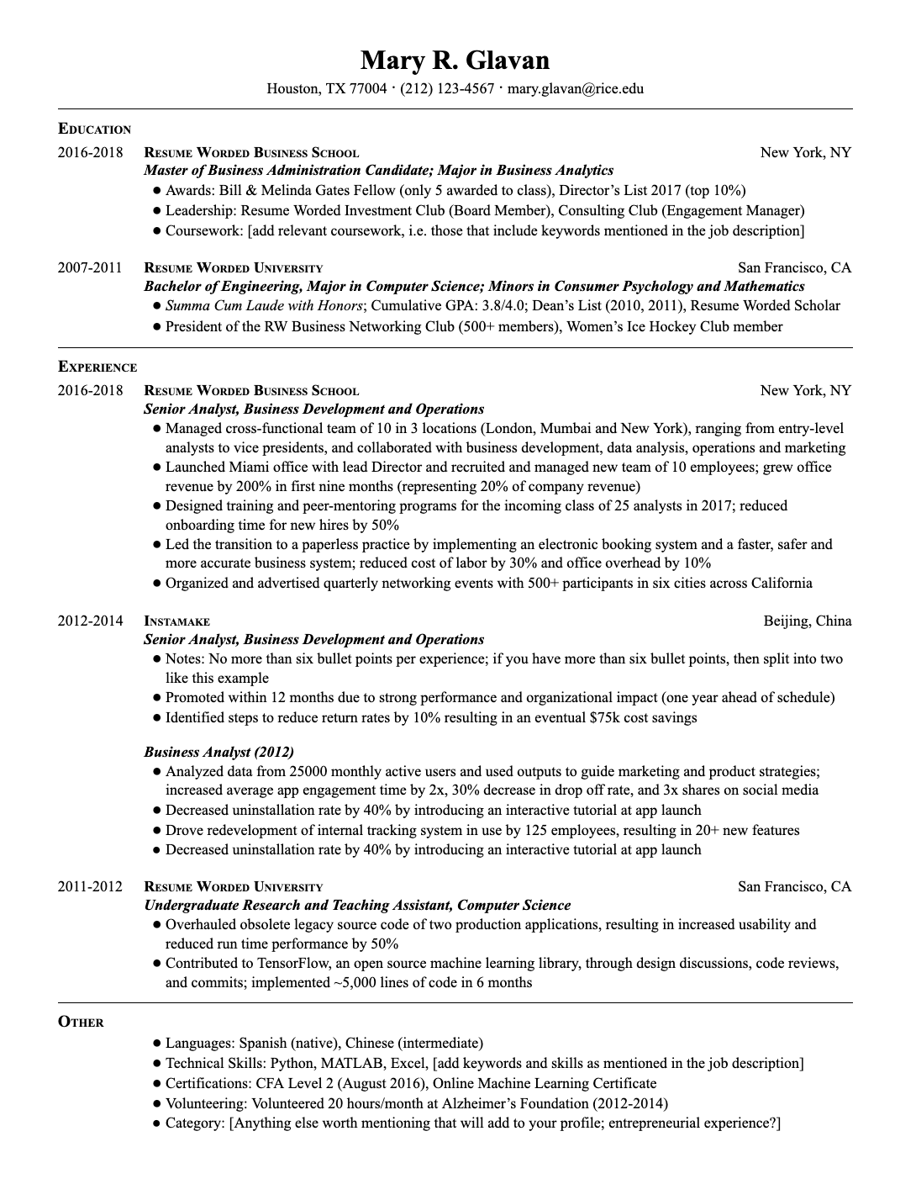
D

